Slide 1

State of maine energy
ALY 6980 – Spring 2022

Slide 2


Executive summary
Executive Summary
The Roux Institute, in partnership with the Maine Governor's Office of Policy Innovation and the Future and the Governor's Energy Office, aims to provide a summary of key features of energy usage and pricing in Maine.
This includes descriptions of the current state on heating fuel consumption and pricing in Maine, comparisons to other New England states, and consumption and pricing forecasts. The outlook described will highlight challenges for Maine and promising trends for the future.

Slide 3


Historical Comparisons
Discuss how Maine compares historically to the other New England states when it comes to heat sources, energy consumption and fuel prices.
Visual Communications
Present new visuals that help the general public to understand the historical price, relative price, and relative efficiency of heating options.
Forecasting
xxxx
Examines the outlook for Maine in terms of energy usage and pricing and sets expectations for how this will change based on current patterns.
xx
3

Slide 4

Forecasting
4

Slide 5
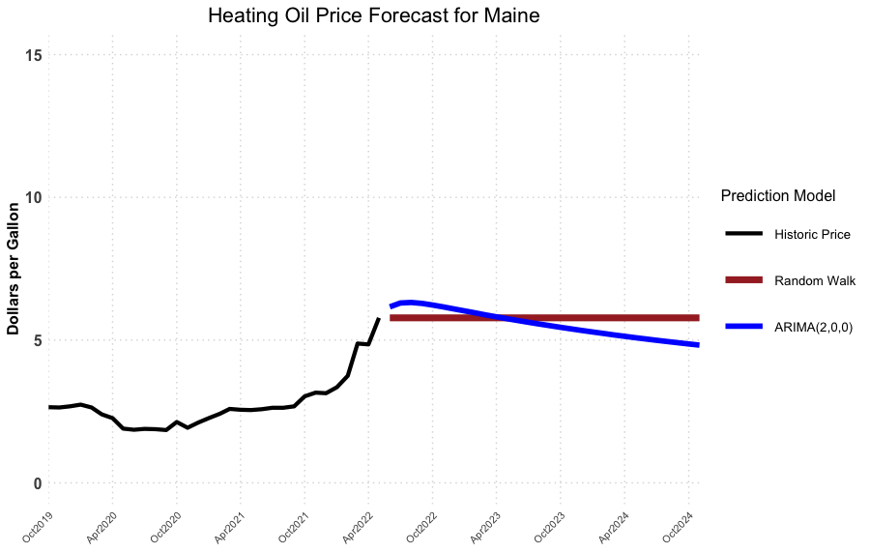
How much can maine residents expect to pay for heating oil in the next two heating seasons?
 | Random Walk Model | ARIMA(2,0,0) Model
Oct 2022 | $5.78 per gal | $6.23 per gal
Oct 2023 | $5.78 per gal | $5.45 per gal
Model Definitions:
ARIMA(p,d,q):
ARIMA = AutoRegressive Integrated Moving Average, with:
p = # of autoregressive terms
d = # of differences needed for
stationarity
q = # of lagged terms for moving
average
Random Walk:
Future steps or directions cannot be predicted on the basis of past history, so the best guess is the most recently known value.

Slide 6
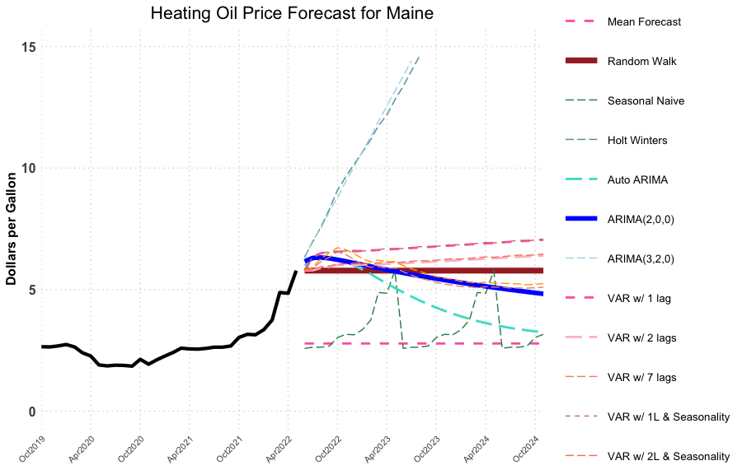
How accurately can we predict the price of heating oil for upcoming heating seasons?
Model | 1-mo MAPE* | 6-mo MAPE* | 18-mo MAPE*
Mean | 22.782% | 23.124% | 23.993%
Random Walk | 3.422% | 13.039% | 28.176%
Seasonal Naive | 18.684% | 19.132% | 32.561%
Holt Winters | 4.226% | 14.909% | 38.484%
Auto Arima | 3.435% | 13.508% | 28.885%
Arima(2,0,0) | 3.444% | 12.828% | 22.685%
Arima(3,2,0) | 3.659% | 18.674% | 51.987%
VAR (1 lag) | 3.326% | 13.109% | 28.358%
VAR (1 lag w seasonality) | 3.414% | 13.080% | 28.345%
VAR (2 lags) | 3.580% | 13.116% | 28.341%
VAR (2 lags w seasonality) | 3.702% | 13.105% | 28.332%
VAR (7 lags) | 4.692% | 13.402% | 28.398%
VAR (7 lags w seasonality) | 4.885% | 13.541% | 28.415%
* MAPE = Mean Absolute Percentage Error

Slide 7
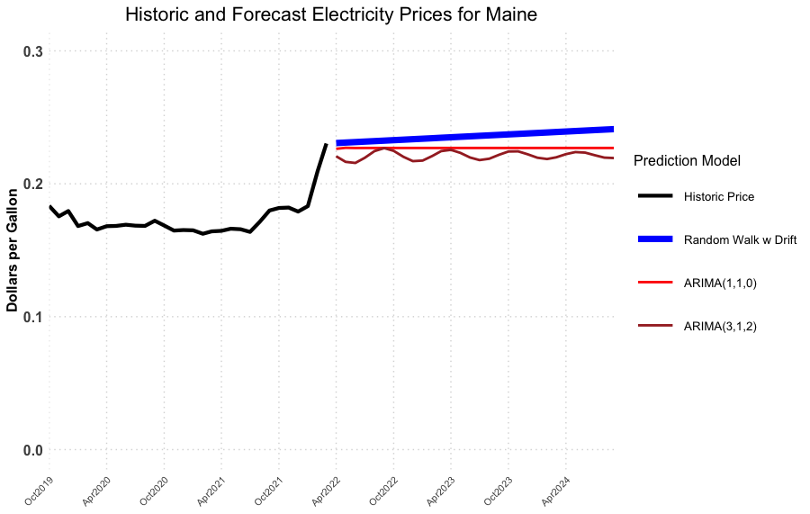
How much can maine residents expect to pay for electricity in the next two heating seasons?
Model Definitions:
ARIMA(p,d,q):
ARIMA = AutoRegressive Integrated Moving Average
p = # of autoregressive terms
d = # of differences needed for stationarity
q = # of lagged terms for moving average
Random Walk with Drift:
Future steps or directions cannot be predicted on the basis of past history, so the best guess is the most recently known value with a small drift/trend term added.
 | Random Walk with Drift Model | ARIMA (1,1,0) Model | ARIMA (3,1,2) Model
Oct 2022 | $0.233/kWh | $0.227/kWh | $0.225/kWh
Oct 2023 | $0.237/kWh | $0.227/kWh | $0.224/kWh

Slide 8
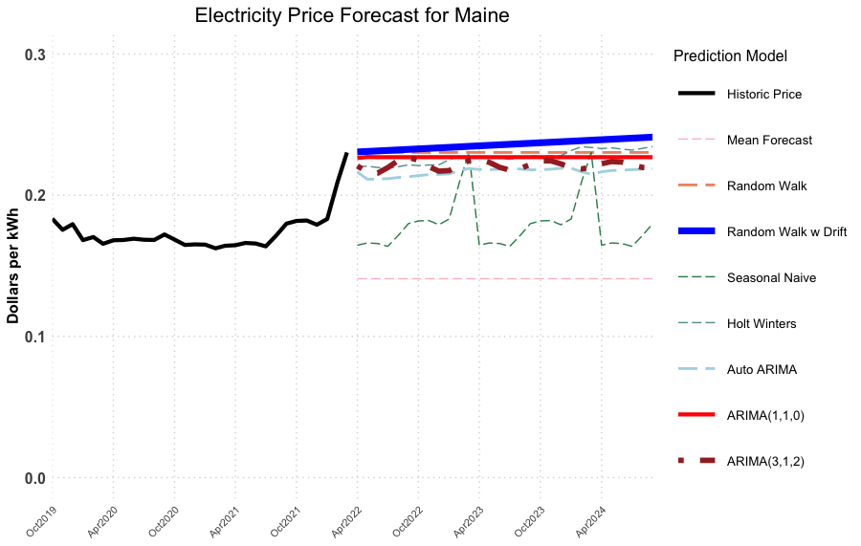
How accurately can we predict the price of electricity for upcoming heating seasons?
Model | 1-mo MAPE | 6-mo MAPE | 18-mo MAPE
Mean | 15.155% | 15.684% | 17.792%
Random Walk | 1.518% | 3.341% | 5.424%
Random Walk with Drift | 1.506% | 3.298% | 4.947%
Seasonal Naive | 4.450% | 4.404% | 6.012%
Holt Winters | 1.762% | 3.633% | 5.467%
Auto Arima | 1.659% | 3.299% | 5.160%
Arima(3,1,2) | 1.691% | 3.187% | 5.340%
Arima(1,1,0) | 1.522% | 3.286% | 5.373%
* MAPE = Mean Absolute Percentage Error

Slide 9
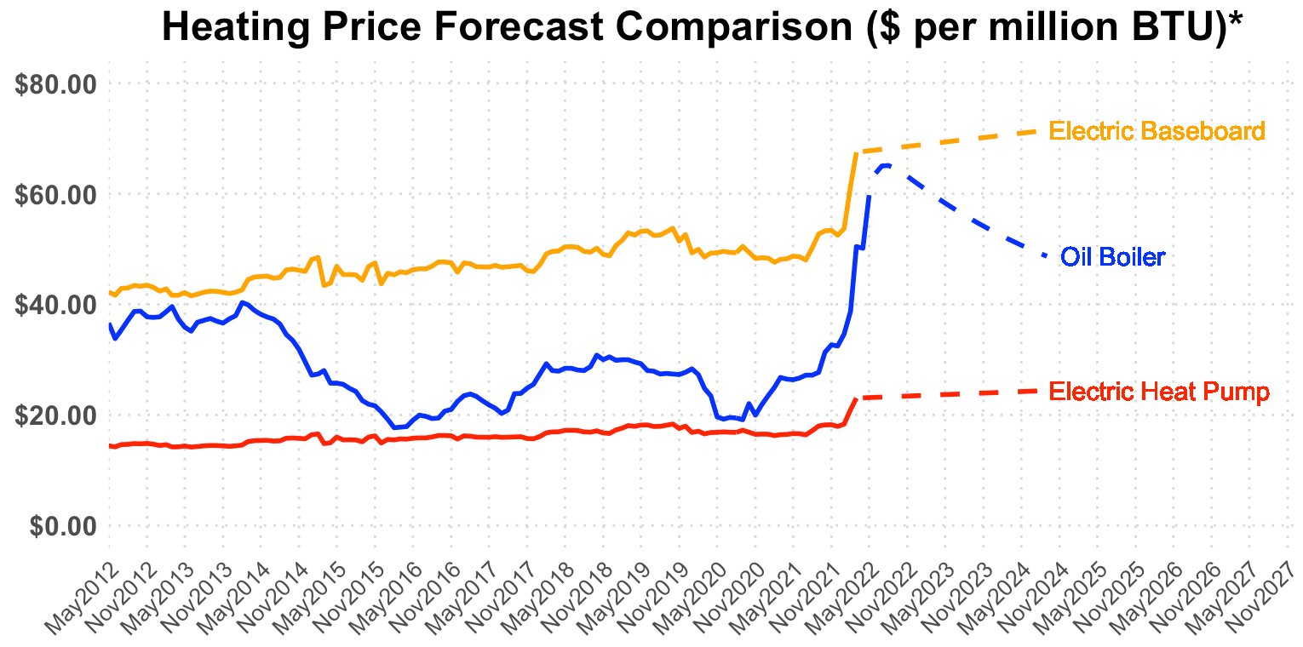
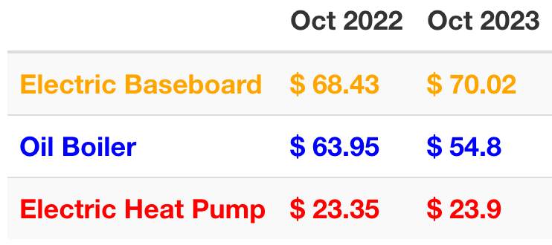
How do the forecasted prices compare in terms of $ per btu?
Oil Boilers
are expected to cost
~2.5x as much as Electric Heat Pumps
to heat a house in Maine for each of the next two heating seasons
* Calculating dollars per million BTU for each heating type was performed using BTU’s per unit, system efficiencies, and distribution efficiencies obtained from Efficiency Maine.

Slide 10

Questions

Slide 11
Appendix

Slide 12
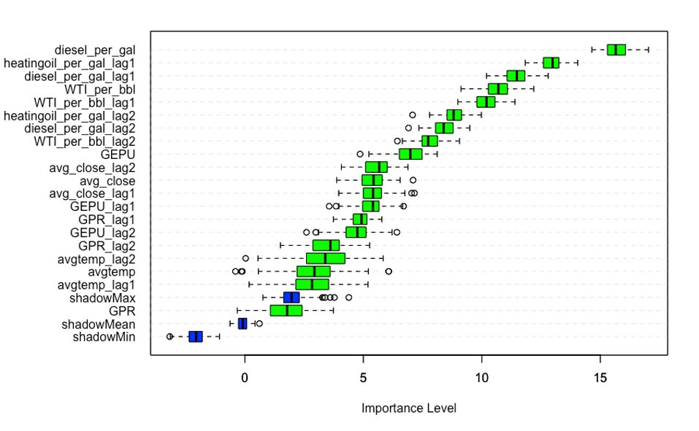
What external factors have the largest effect on PREDICTING the price of heating oil?
Variable importance analysis using the Boruta algorithm and 100 random forest iterations with all variables, including 2 lags for each.
New England Diesel Price
Maine Heating Oil Price (lag 1)
New England Diesel Price (lag 1)
Crude Oil Price
Crude Oil Price (lag 1)
Maine Heating Oil price (lag 2)
New England Diesel Price (lag2)
Crude Oil Price (lag 2)
Economic Policy Uncertainty Index
S&P500 Avg. Closing Price (lag 2)
S&P500 Avg. Closing Price
S&P500 Avg. Closing Price (lag1)
Economic Policy Uncertainty Index (lag 1)
GeoPolitical Risk Index (lag 1)
Economic Policy Uncertainty Index (lag 2)
GeoPolitical Risk Index (lag 2)
Average Maine Temperature (lag 2)
Average Maine Temperature
Average Maine Temperature (lag 1)
"shadow Max"
GeoPolitical Risk Index
"shadow Mean"
"shadow Min"

